Slide 1
Project NOBLE
Projecting Strikes Against Ukrainian Infrastructure with Markov Transitions
Earp, Mason, Dallas, Ryan
Egl, Hannah Lumpkin, Bree

Slide 2
Notes
The full code, all matrices and tables, and answers to the prompted questions can be found in the accompanying Jupyter notebook.
Claude was used to troubleshoot code, but no code written by Claude was used for the simulation (i.e., code written by Claude for troubleshooting was removed after bugs were identified). Therefore, Claude’s only influence is the adjustment of pre-existing code originally based on Assignment 5 and course content downloaded from the course GitHub.

Slide 3
Data Summary
This analysis models the sequence of infrastructure damage in Ukraine. Its not just the volume attacks, but their order and progression overtime , specifically, whether an attack in one location or one type of infrastucture increases the probability of the next attack occuring in another location or on another specific type.
Attribute | Categorization | Data Type | Description/Purpose
Damage_id | Categorical | String | Unique identifier for each damage report. Helps track individual events.
Oblast | Categorical | String | Region where the damage occurred. Used for spatial comparisons and state modeling.
Rayon | Categorical | String | Sub-region within an oblast. Provides additional geographic detail.
Type_of_infrastucture | Categorical | String | Type of asset damaged (e.g., warehouse, bridge, health facility). Core variable for identifying what was hit.
Extent_of_damage | Categorical | String | Severity of damage (“Destroyed”, “Partially damaged”, “Unknown”)
Date_of_event | Continuous | Datetime | Exact date the damage occurred. Used to create weekly/monthly transitions.
Oblast pcode | Categorical | String | Administrative code used for mapping or merging with other datasets.
_weights | Continuous | Numeric | Confidence score for the damage report (0.7 or 1.0). Useful for weighting observations if needed.

Slide 4
Target Variables
oblast: We are using the oblast of the current damage event to predict the probabilty of where the next damage event will occur. The output isn’t a single location, but a probability distribution accross all possible locations.
rayon: Allows us to see patterns within a region
type_of_infrastructure: To predict the type of the next target. This allows you to see any attack patterns.

Slide 5
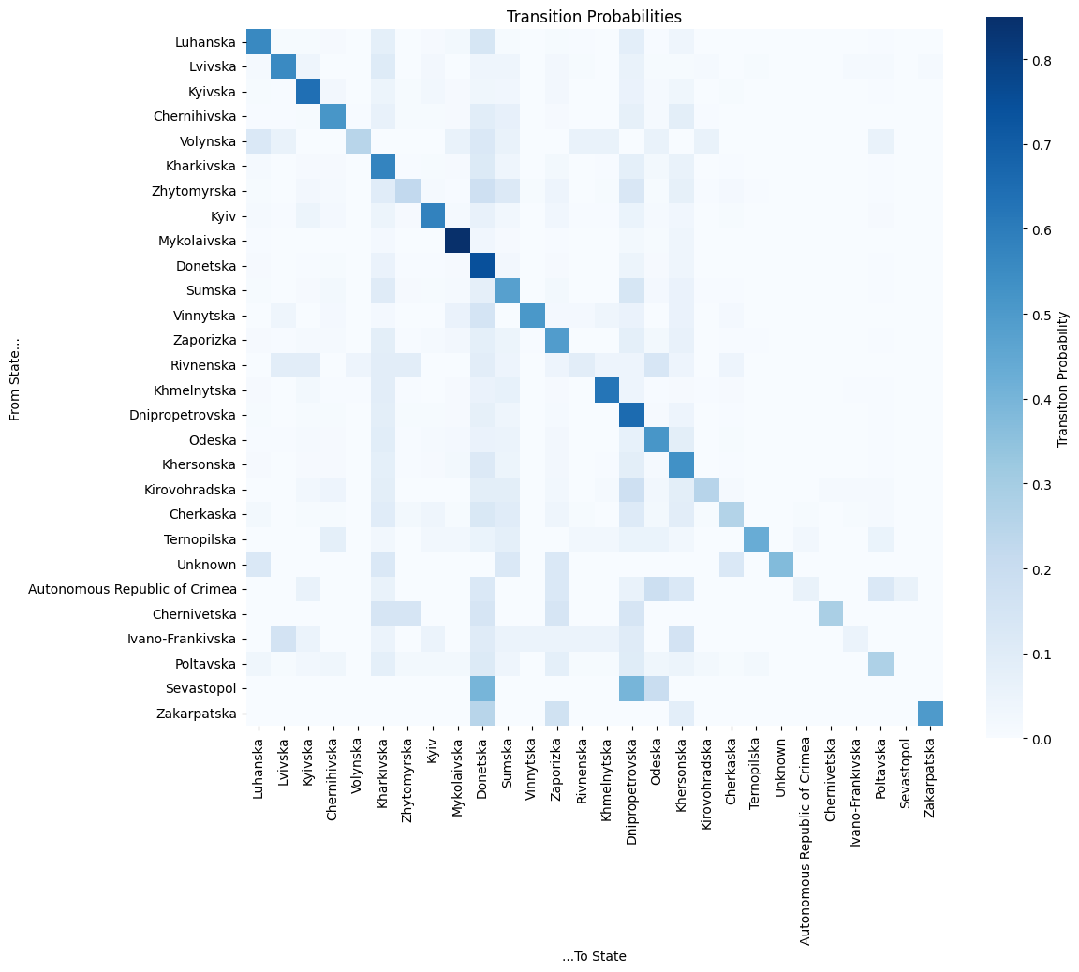
Markov Transition Heatmap
Oblast Data

Slide 6
Markov Transition Heatmap
Oblast Data
Sources/Origin
  Row of Heatmap

Slide 7
Markov Transition Heatmap
Oblast Data
Sources/Origin
  Row of Heatmap
Destinations
  Column of Heatmap

Slide 8
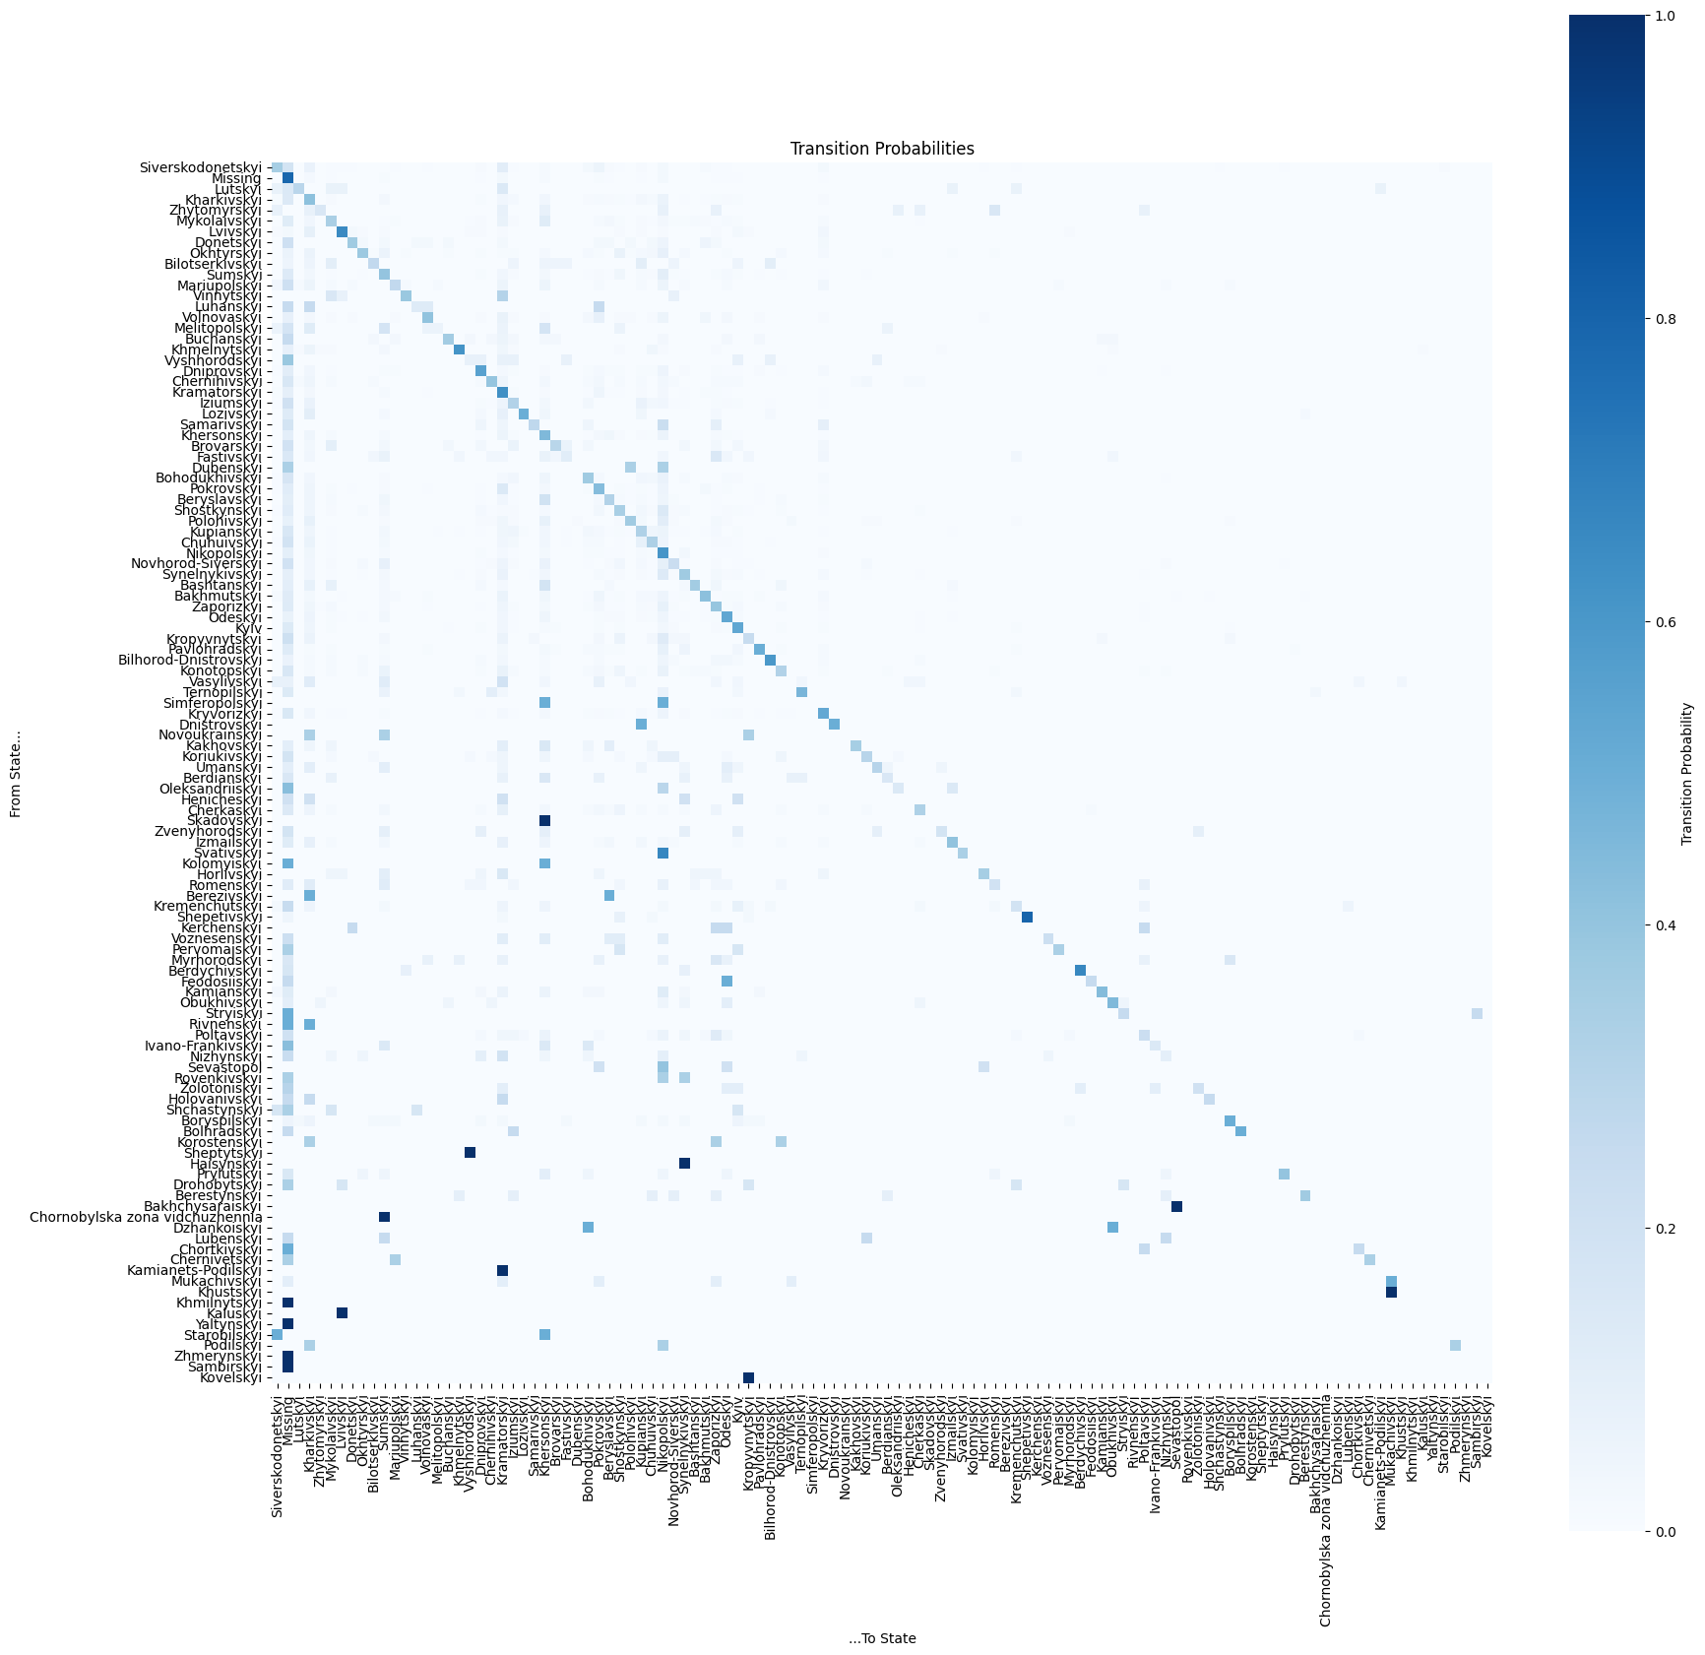
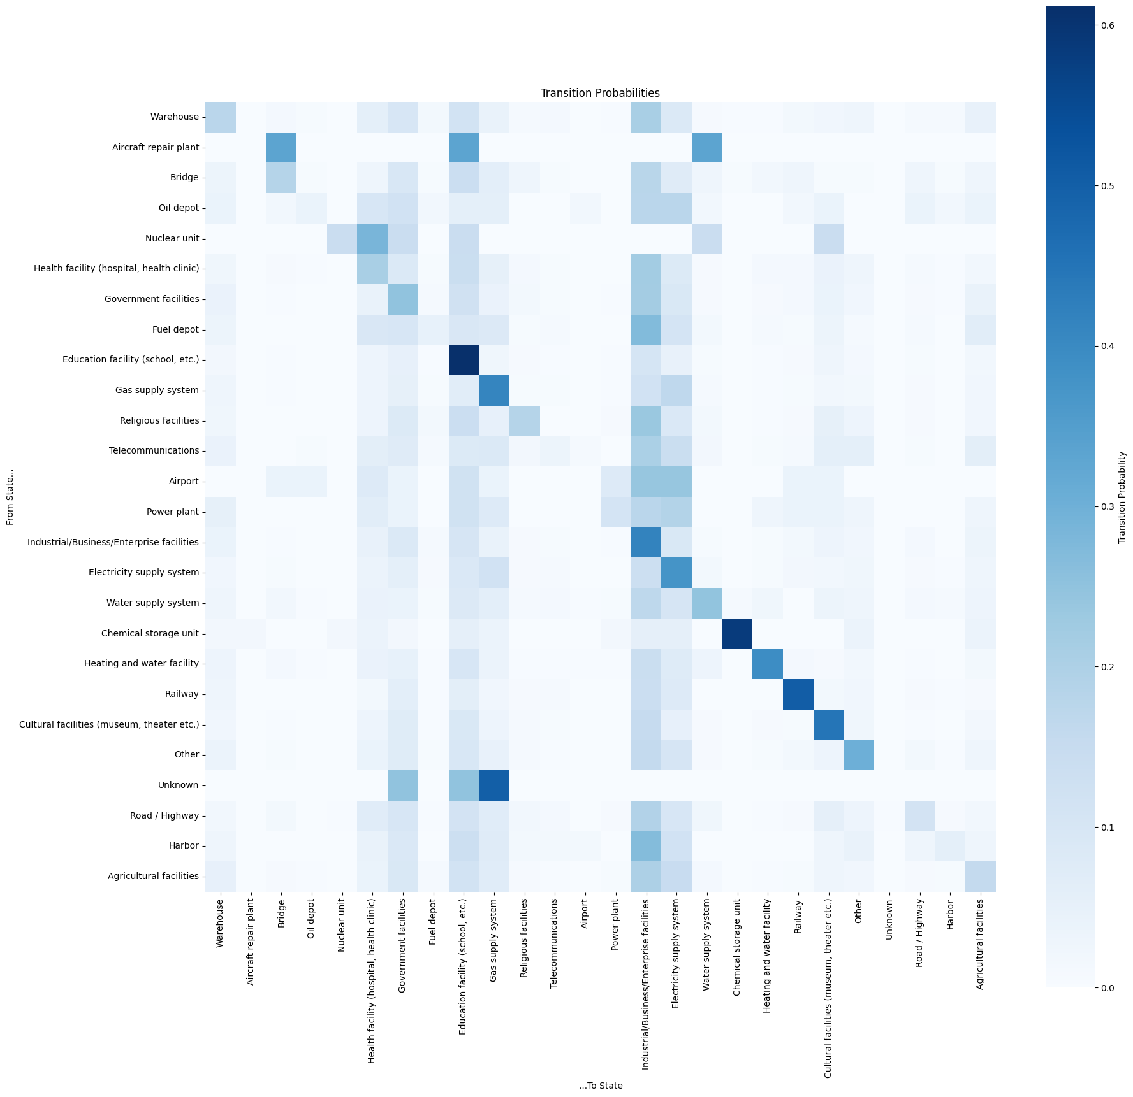
Rayon Heatmap
Infrastructure Heatmap

Slide 9
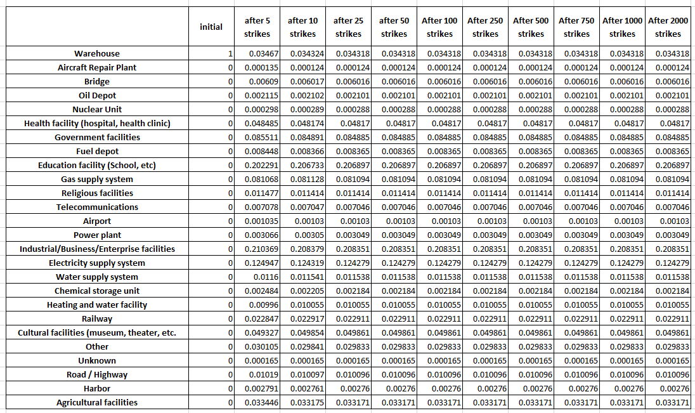
Results
Infrastructure Markov Projection Numbers
Full tables can be found in the accompanying notebook

Slide 10
Results (2) - Oblasts
Strikes in Donetska: 0.2512
Strikes in Donetska : 0.2512
Strikes in Kharkivska: 0.1398
Strikes in Dnipopetrovska: 0.1670
Strikes in Kharkivska : 0.1398
Strikes in Dnipopetrovska : 0.1670

Slide 11
Results (3) - Rayons
Strikes in “Missing”: 0.3593
Strikes in “Missing”: 0.3593
Strikes in Kramatorskyi : 0.0937
Strikes in Kramatorskyi: 0.0937
Strikes in Nikopolskyi : 0.1020
Strikes in Nikopolskyi: 0.1020

Slide 12
Results (4) - Infrastructure
After approx. 25 strikes, Industrial targets settle out to 0.2084, Educational Facilities to 0.2069
Electricity Supply targets: 0.1243
Government targets: 0.0849,
Gas Supply targets: 0.0811

Slide 13
Results (5) – Infrastructure, Recoded
After approx. 15 strikes, Civilian targets settle out to 0.3234
Business targets: 0.2427
Power & Fuel targets: 0.2427

Slide 14
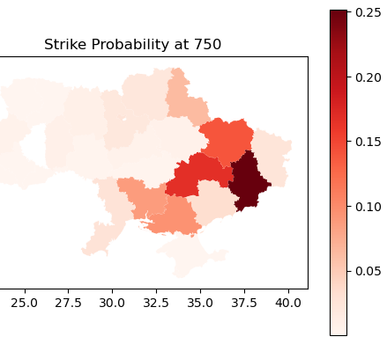
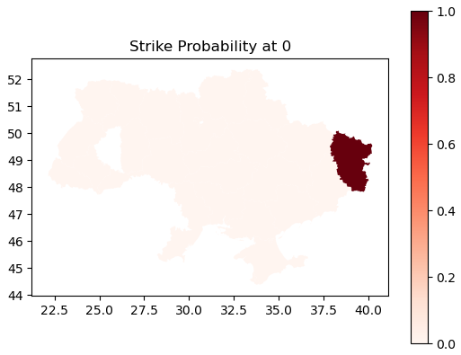
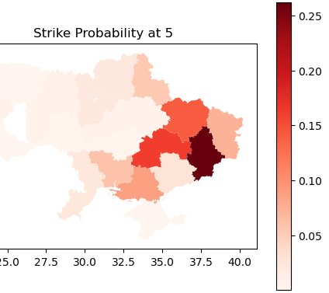
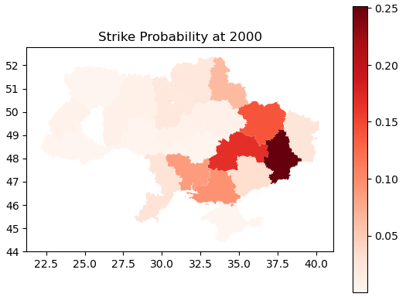
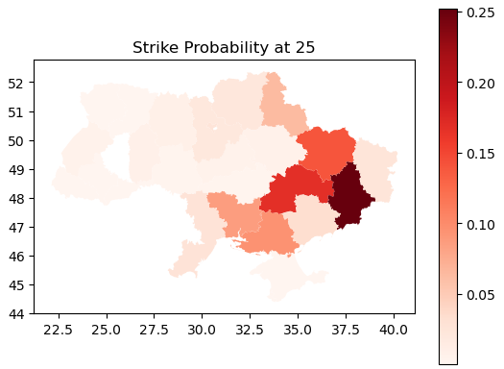
Expansion
(geo data)
Visualizing the probabilities across Oblasts (states) after t number of strikes
Visualization and geocoding completed via Geopandas package and QGIS

Slide 15

